Slide 1


Working Paper No. 5
Team A
Roy Madpis - Rawaa Makhoul - Alexandra Fatieieva

Slide 2

- Guideline -
Recap
Improving the performance of our model
Evaluating the model’s performance

Slide 3
- Recall -
Classification XGBoost model: realized return’s probability to be higher or lower than 2%
• “0” – realized return > than 2% - this is the “common class”.
• “1” – realized return < than 2%.

Slide 4

- Recall -
To finalize the model selection, we use:
Accuracy
NPV (Negative predictive value)
Weighted average realized return gained from the Suggested Portfolio

Slide 5

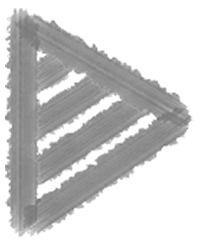
- 3 steps of Fine tuning -
Feature Engineering
Feature Selection
Parameter Optimization
Cross Validation
→ Goal: increase mean Accuracy & NPV

Slide 6
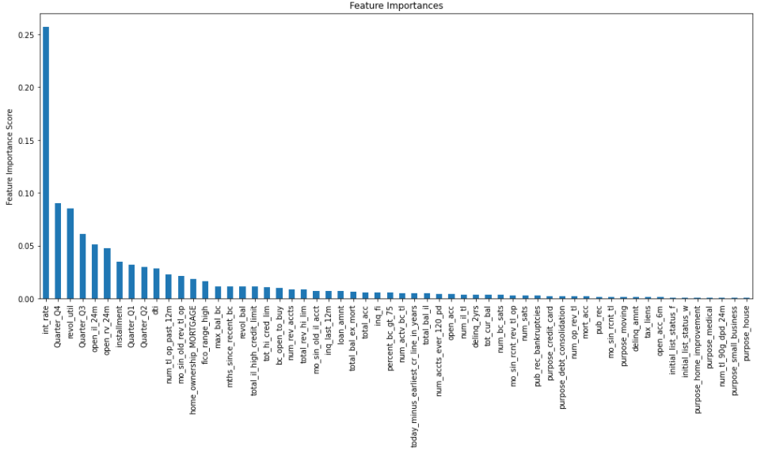
Feature Engineering
There are numerous options of features we can create
Feature Importance

Slide 7
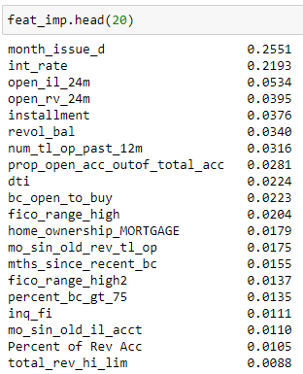
Feature Engineering
6 new features are used in the final model
* 4 of those were among the first 20 features in means of feature importance

Slide 8
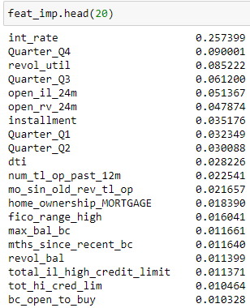
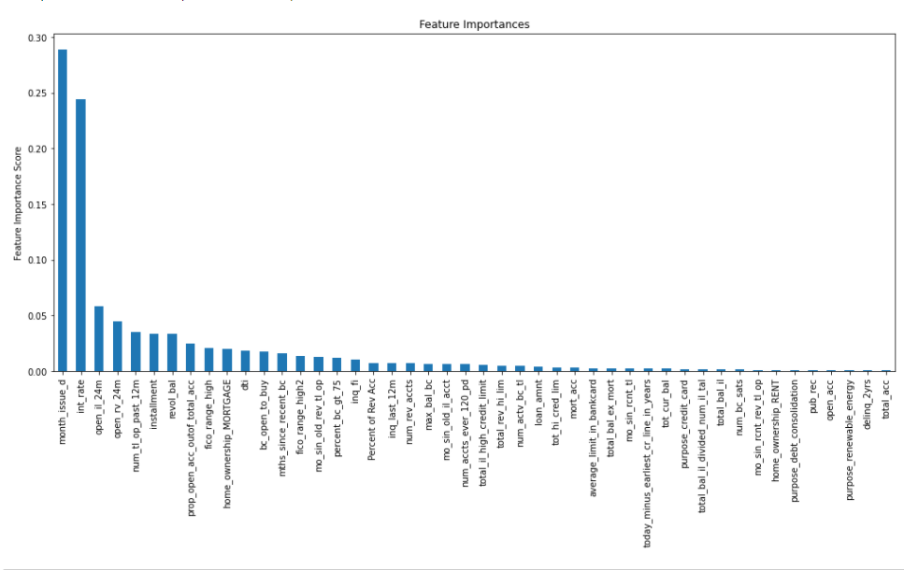
Feature Selection
Performed twice:
Before the feature engineering:
After the feature engineering:

Slide 9

Feature Selection
We performed backward feature selection to find features that are not relevant for the model, i.e., lowers its accuracy
The feature selection was performed twice – before and after the feature engineering

Slide 10
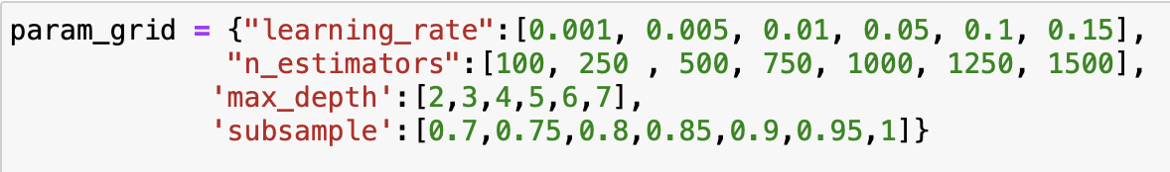
Parameter Optimization
XGBoost has many hyperparameters that we can tune
HalvingGridSearch

Slide 11
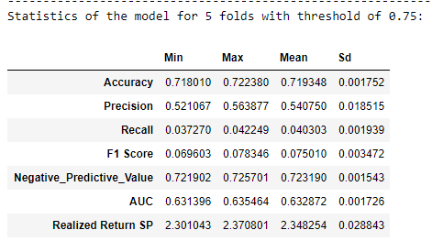
Cross Validation

Slide 12
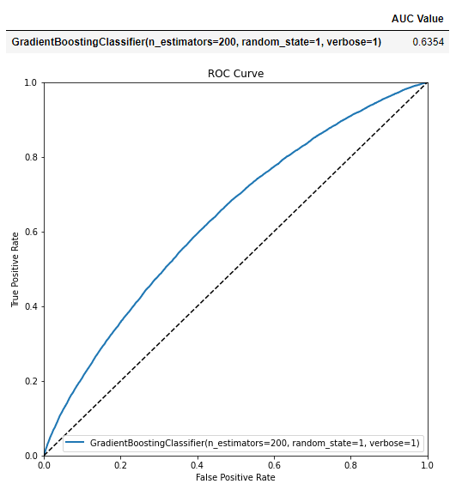
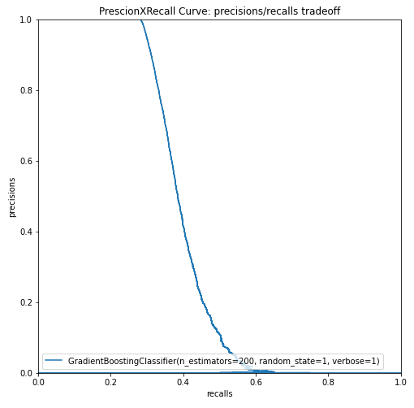
- Final graphs -
The ROC Curve
The Precision VS Recall Curve

Slide 13
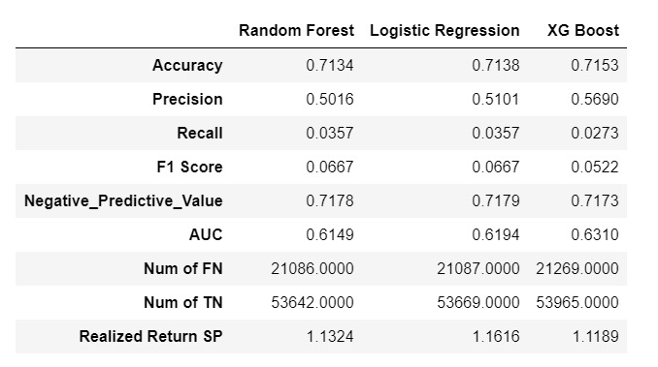
Achievements
Increase in Accuracy and NPV
→

Slide 14
Conclusions

Slide 15
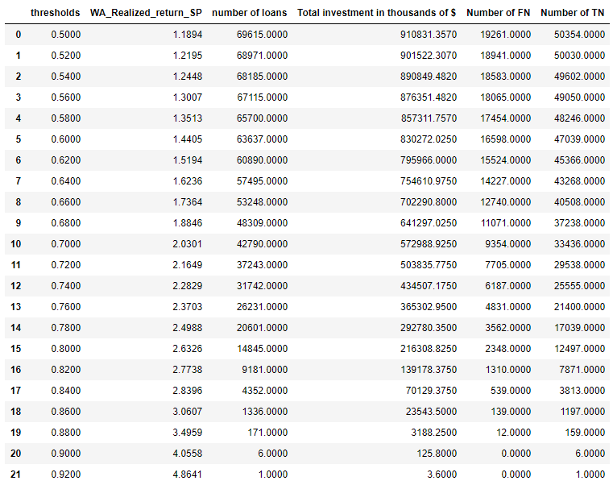
- Recall – Threshold = 0.75

